Slide 1
Online Attendance System
Github Project Repository
Group 10

Slide 2
Problem Statement
Online Attendance Management System is an innovative tool to maintain and manage the attendance of students. These tools can be software to monitor attendance details. Also this provides transparency in the system so that each student can view their attendance from anywhere, anytime.

Slide 3
Project Objective
Our main objective is to implement such attendance system where the professor could monitor whether the students are attending the lectures or not since in Online lectures students tend to skip lectures as professor couldn’t monitor students activity. Also the professor will have information about the percentage of student’s attendance and can notify them if someone’s attendance is below par.

Slide 4
Project Specifications
Skills and Platforms
Functional Requirements
Non-Functional Requirements
Elicitation Techniques
Use Case Models
Activity Diagram
Further Development

Slide 5
Skills & Platforms
MongoDB
NodeJS
Github
HTML, CSS,JS

Slide 6
Functional Requirements
User - Professor
04
Can remove students from the course, can download the csv of attendance of all students in decreasing order of their percentage of attendance.
Professor can login, create courses, create a entry for new lecture, can send links to every eligible student.
01
03
The link will be active for a certain period of time and will be unique for every student.
The professor can see attendance of all students and can change the criteria for attendance also.
02

Slide 7
Functional Requirements
User - Student
04
They can see which courses they are attending
Students can see whether they are above par, i.e., attendance criteria set by the professor
01
03
Students can see the percentage criteria set by the professor
Upon receiving the link, students need to click the link to mark their attendance.
02

Slide 8
Non-Functional Requirements
04
Security
Operability
01
03
Performance
Maintainability, Scalability
02

Slide 9

Process Model - Waterfall
Elicitation Techniques
QUICK TIP
Try right clicking on a photo and using "Replace Image" to demonstrate your prototype.
Interviews
Use Case
Brainstorming

Slide 10
Use Cases
S -Student ; P - Professor
Login
Enroll into course
Create Course
Send Attendance links
Mark Attendance
View Attendance(S)
View Attendance(P)
Download Attendance
QUICK TIP
Try right clicking on a photo and using "Replace Image" to demonstrate your prototype.

Slide 11
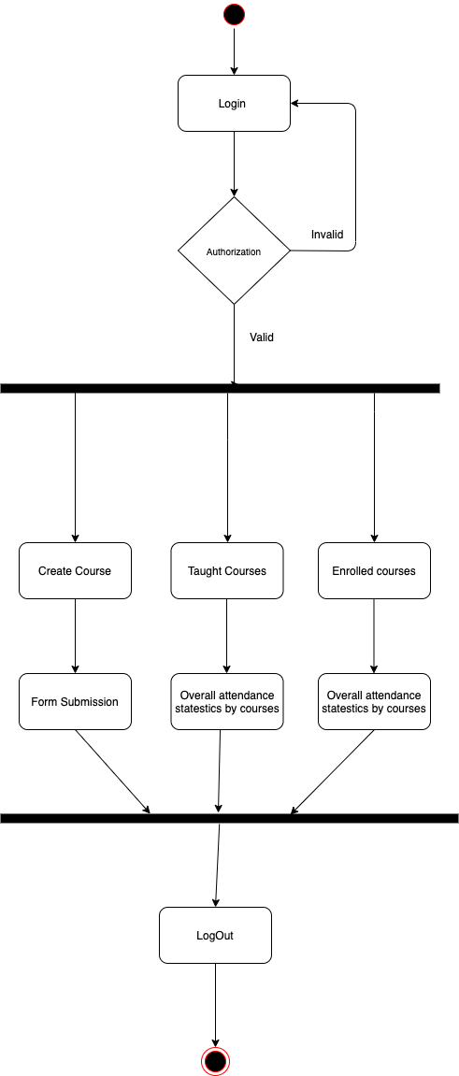
AAc
Activity Diagram

Slide 12
Further Development
8th April
13th April
15th April
16th April
20th April
23rd April
Back-end
Back-end
Back-end
Front-end
Front-end
Deploy
User, Lecture and course models for basic CRUD operations
Create endpoint for enrollment emails to all students
Attendance data aggregation
User friendly frontend
Informative dashboard containing aggregate attendance data
Test the application for bugs and then deploy

Slide 13

Thank you!
Group Members :
Hemant Jain (201801032)
Akshay Mungalpara (201801024)
Pushpang Singh Rathore (201801037)
Chirayu Chaplot (201801038)
Rohit Yasmani (201801079)
Milin Mistry (201801125)
Keval Thakarar (201801157)
Raj Desai (201801183)
Umesh Savaliya (201801189)
Richa Patel (201801245)

